Slide 1
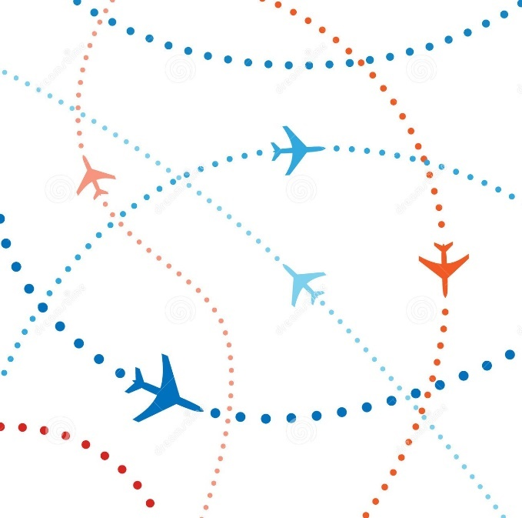
Airplanes Safe Distance
Presented By:
Abdulaziz Al-Maghlouth
Khaled Al-Mana
Salman Al-Quaimi

Slide 2
Presentation Content
Introduction
Intended Audience
What are the procedures to predict the collision? ‘Algorithm’
Program workflow
Conclusion

Slide 3
Introduction
Why we are doing this project?
What are the pros of this project?
Is it a useful project?

Slide 4
Intended Audience
Air Traffic Controller:
People with high skills and expert enough who’s job to maintain the following:
landing and departing of Airplanes
Monitoring all airplanes in the airspace
Keeping all airplanes in a safe distance
Preventing collision

Slide 5
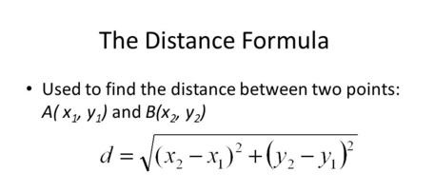
What are the procedures to predict the collision? “Algorithm”
In the Algorithm:
Comparing elements up to [ n-1, n ] using 2 for loops.
Using “Pythagorean theorem” to checks the distance.
Calculating the time needed to reach the intersection point by [ t = d/s ].
Returns the status of predicted collisions to take action.
Pythagorean Theorem

Slide 6
Program workflow
Using Java The program will:
Read the input from file
Calculate
Show the result
Show the simulation

Slide 7
Conclusion

Slide 8
Questions and Answers

Slide 9
Thank you!

